Slide 1
ACLU of Colorado
Freedom of Information Act (FOIA)
request re:
Joint Terrorism Task Force (JTTF)

Slide 2
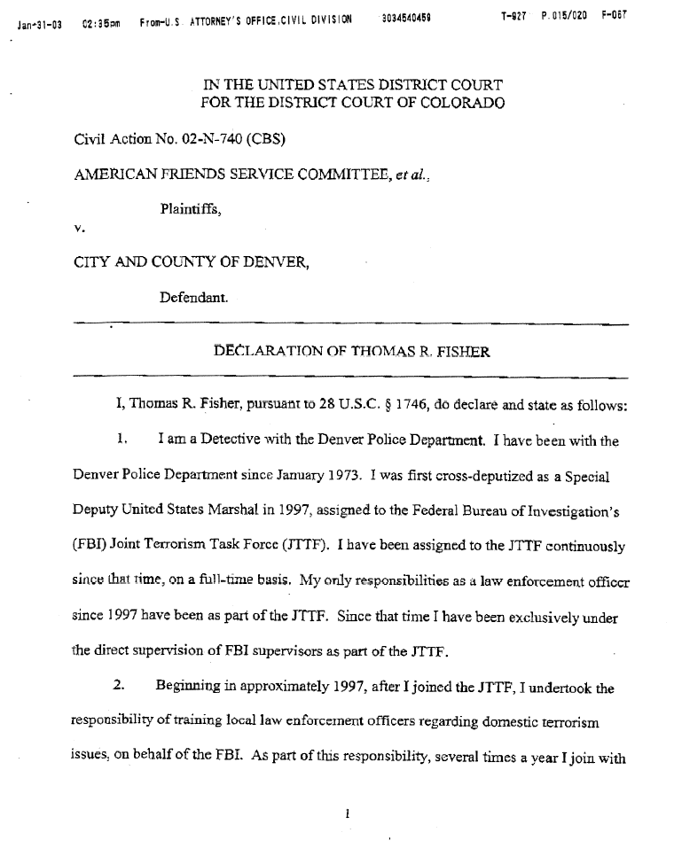
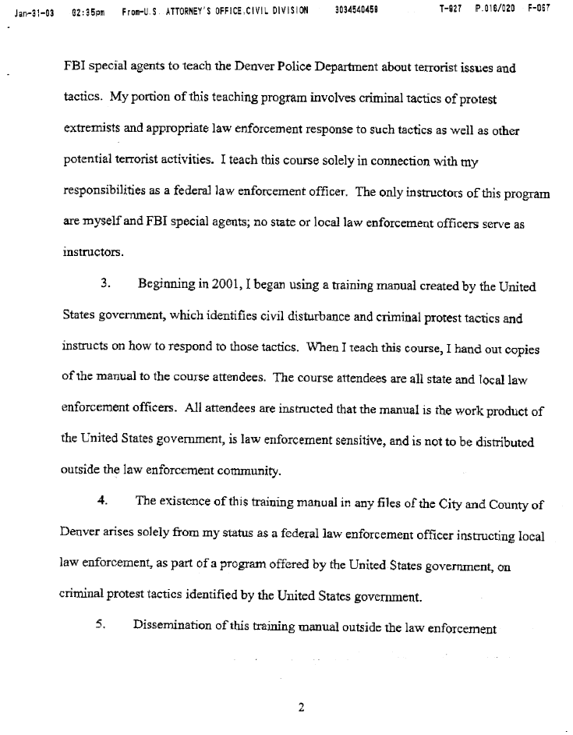
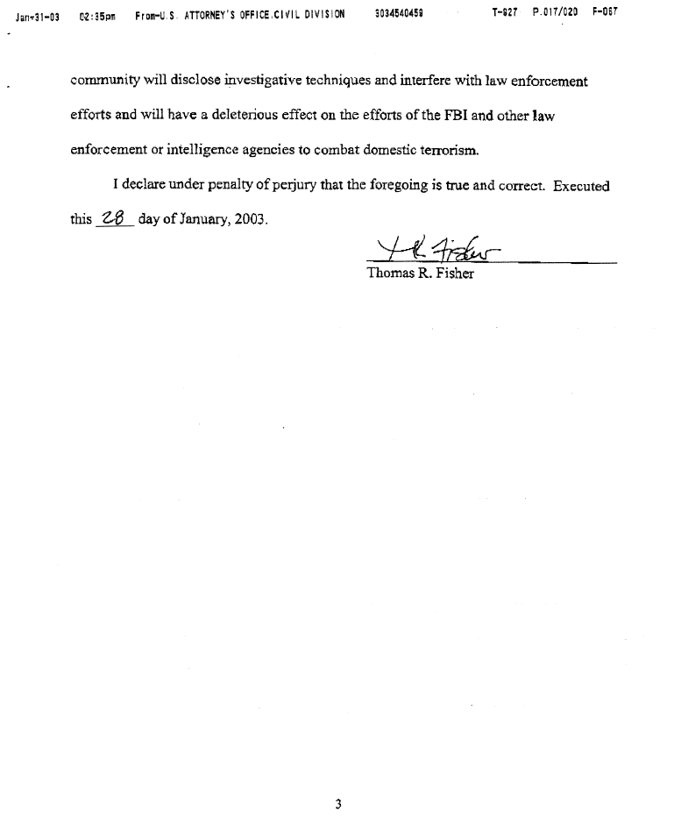
Thomas Fisher Assigned to JTTF since 1997

Slide 3
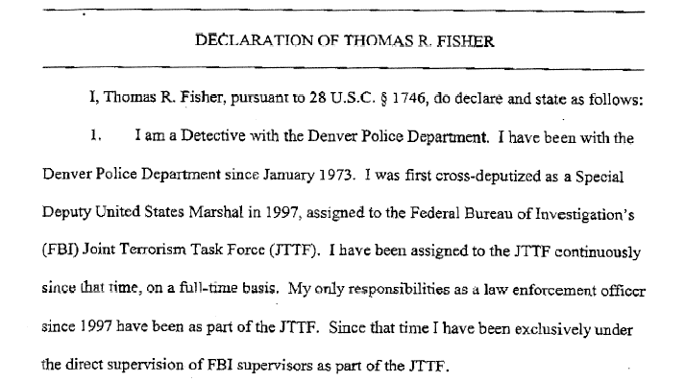


Slide 4
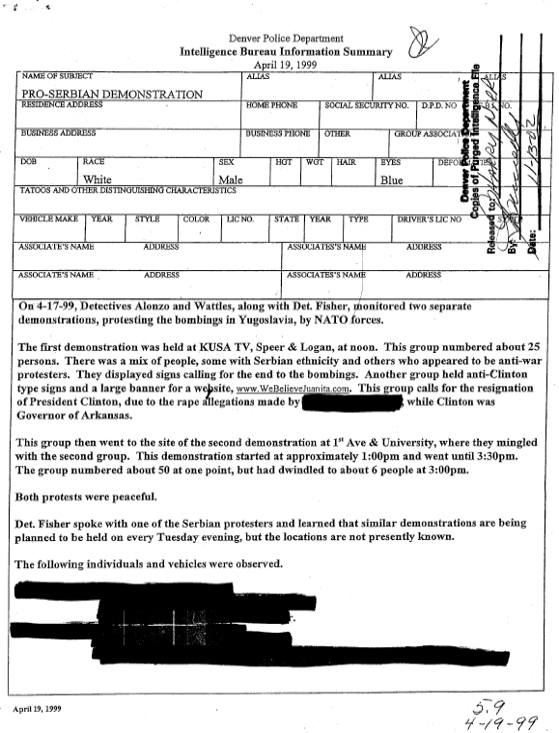

JTTF monitors peaceful demonstrations
Page 1

Slide 5
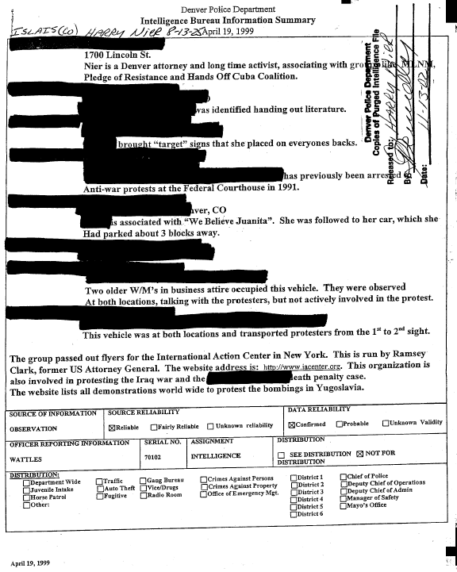
Page 2

Slide 6
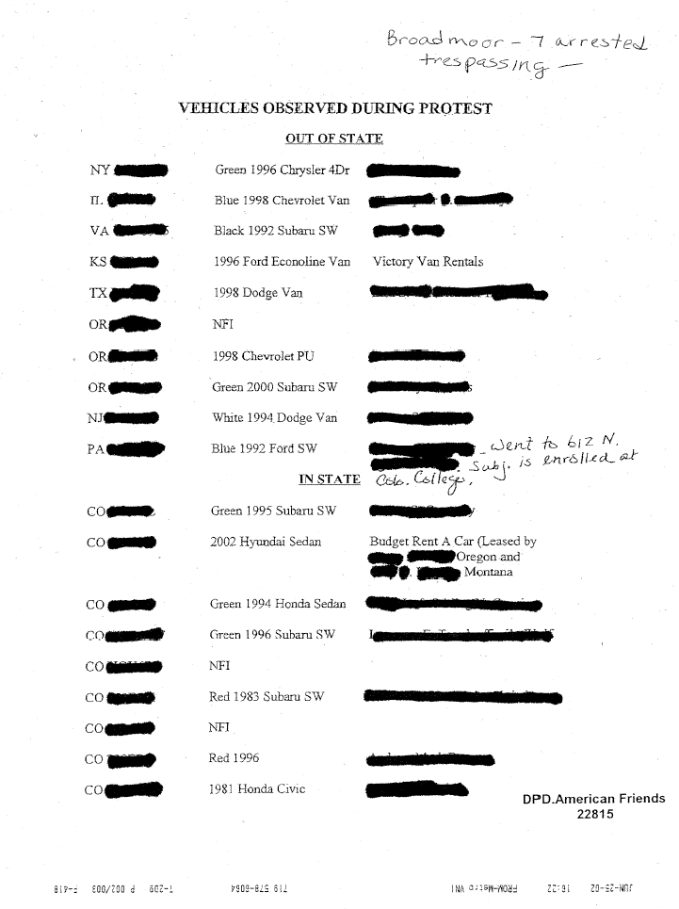
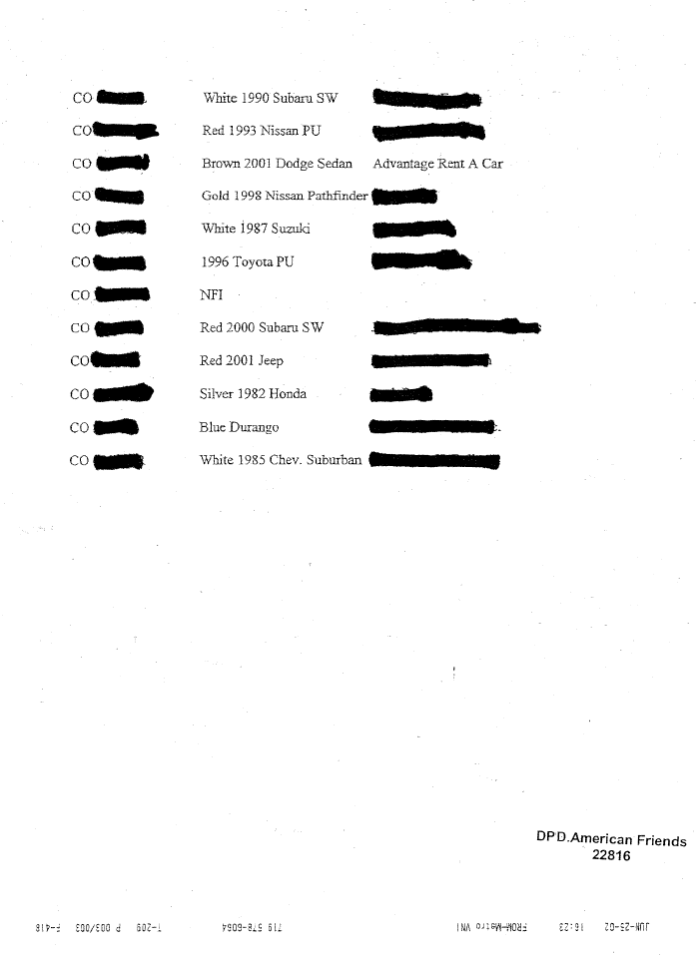
Names and license plate numbers of peaceful demonstrators

Slide 7


Slide 8
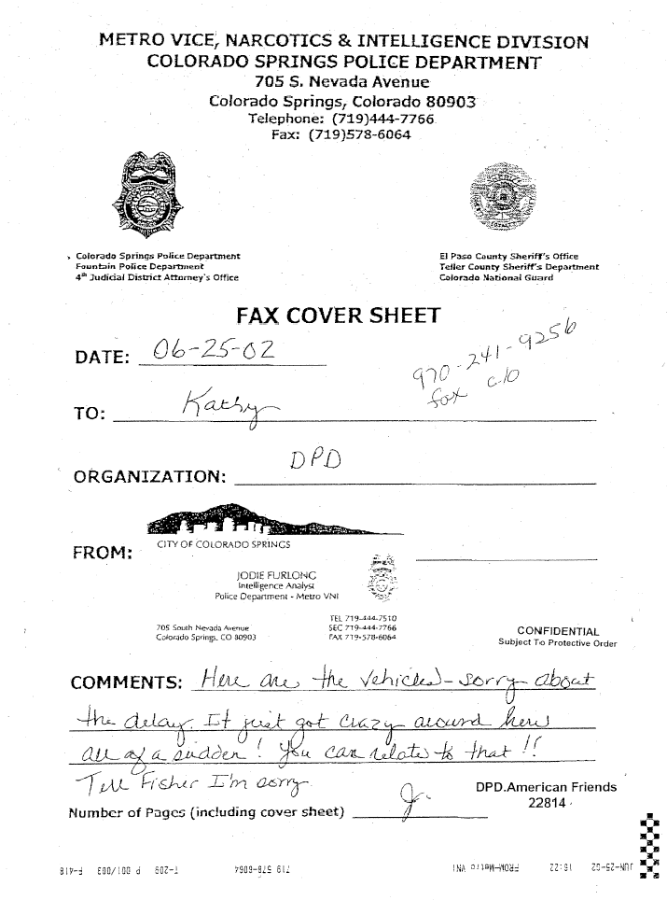
Names and license plate numbers of peaceful demonstrators

Slide 9
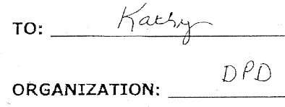
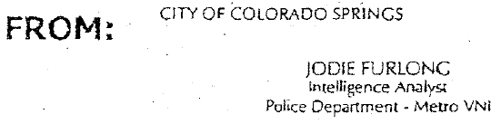

Slide 10
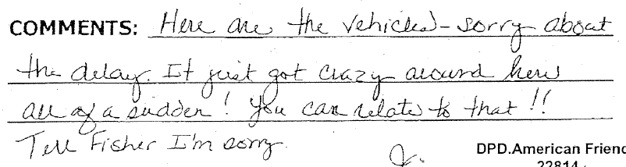

Slide 11
FBI Embroiled in 'Spy Files'
Feds sought intelligence on environmental rally in the Springs
Source: Colorado Springs Independent Article May 8-14, 2003 by Terje Langeland
The Denver and Colorado Springs police departments aren't the only agencies that have collected intelligence about political activists in the Springs. The Federal Bureau of Investigations has, too.
In the first admission linking the FBI to the Denver Police Department's controversial "spy files," the agency confirmed this week that it had sought information on activists attending a protest rally in Colorado Springs in June of last year. An FBI anti-terrorism agent asked Springs police to provide him with the vehicle license-plate numbers of environmentalists who were picketing a timber-industry gathering at The Broadmoor hotel, confirmed Ann Atanasio, a spokeswoman for the FBI's Denver division.
The FBI also knew about the rally in advance and warned the industry group meeting at The Broadmoor that it might be targeted by protesters, the industry group's president said.

Slide 12
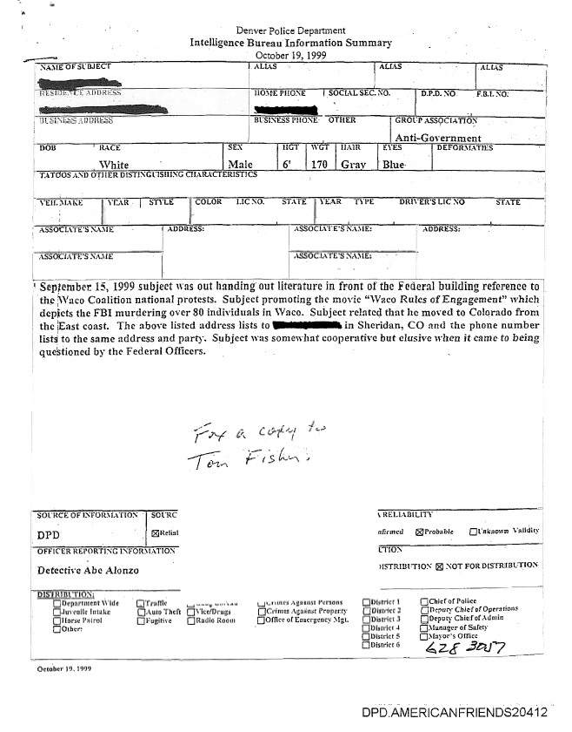
Report on person promoting documentary film that criticizes FBI

Slide 13
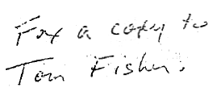

Slide 14
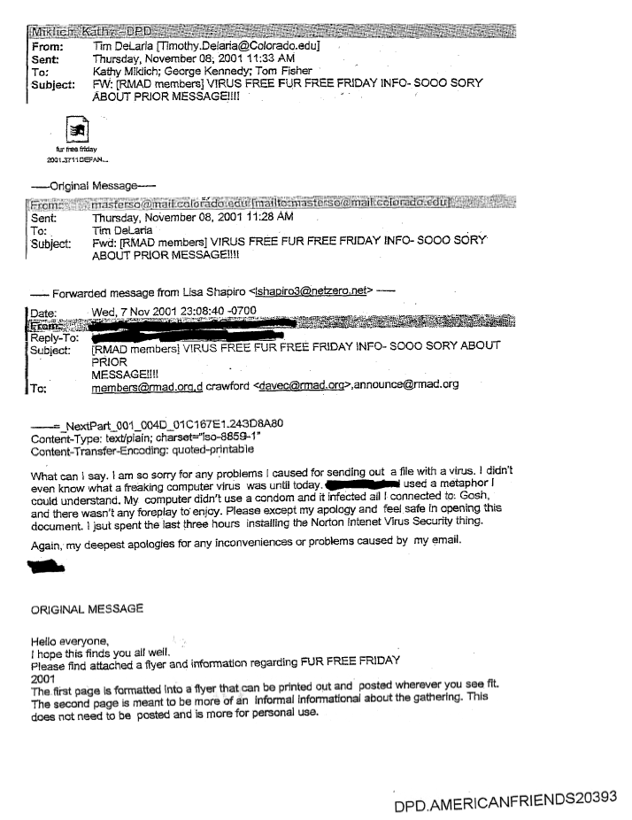
Intercepted e-mail announcing protest by Rocky Mountain Animal Defense

Slide 15


Slide 16


Slide 17
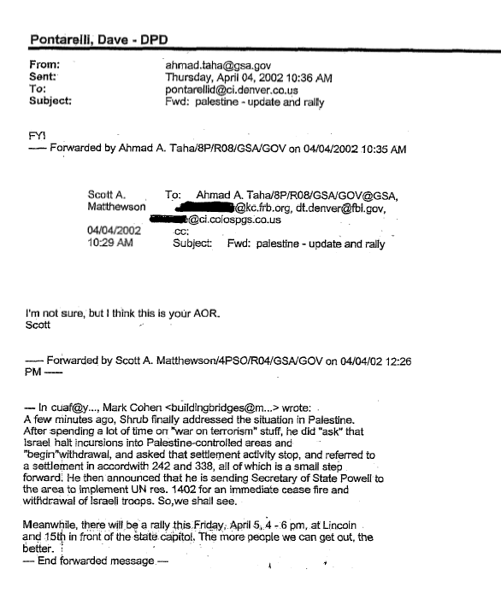
Intercepted e-mail announcing rally about Palestine

Slide 18

Intercepted e-mail announcing rally about Palestine

Slide 19
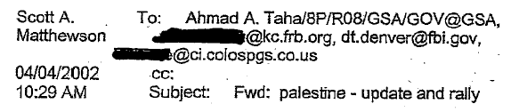
Intercepted e-mail announcing rally about Palestine

Slide 20
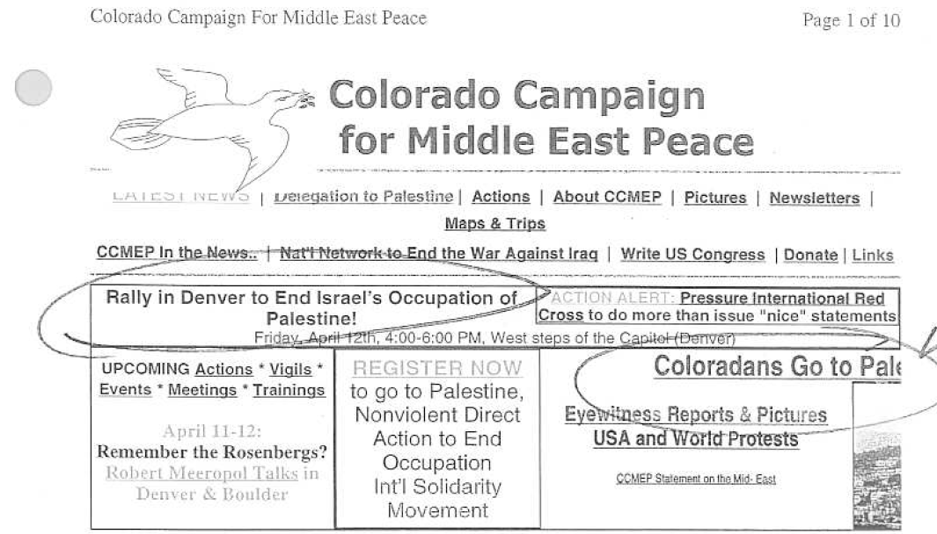
JTTF Active Case List

Slide 21
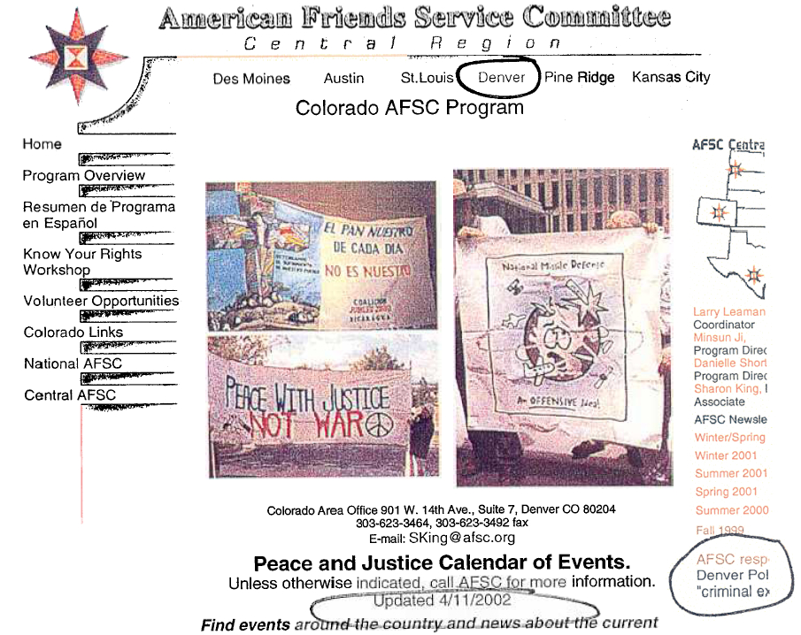
JTTF Active Case List

Slide 22
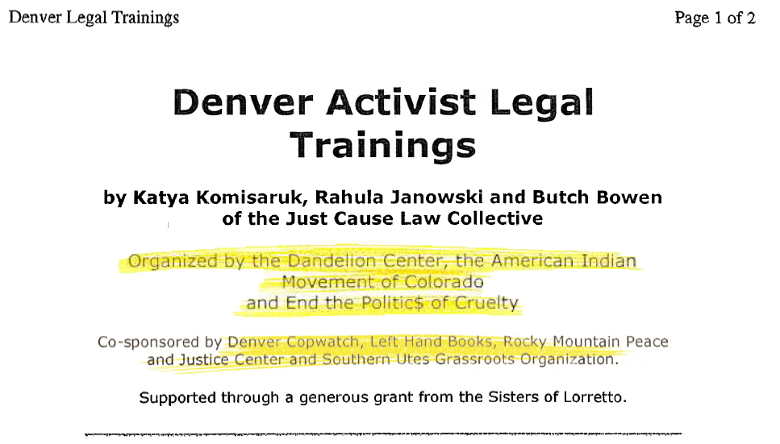
JTTF Active Case List

Slide 23
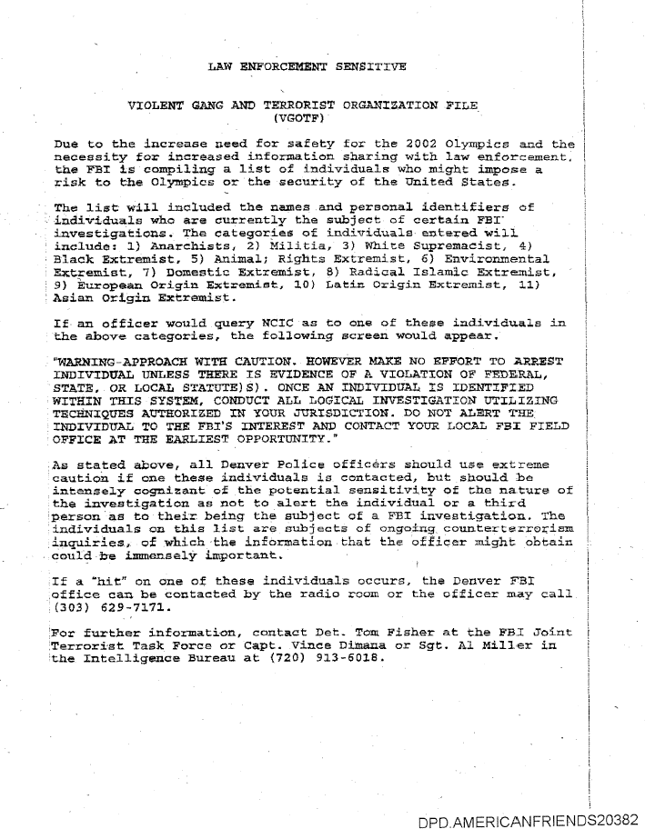
“Extremists” listed in FBI’s Violent Gang and Terrorist Organization File

Slide 24
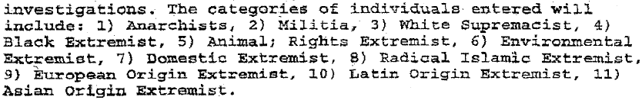

Slide 26
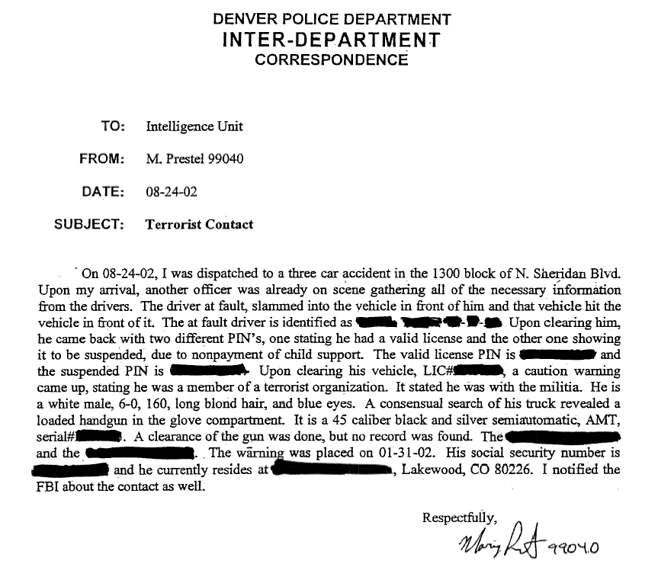

Slide 28
Terrorism is as Terrorism Does
Local peace activist may be on FBI list
Source: Colorado Springs Independent Article June 6-12, 2003 by Terje Langeland
Bill Sulzman has protested nonviolently against U.S. military policy for more than 30 years. That, he discovered last week, apparently makes him a "terrorist" in the eyes of the government.
…
Four protesters refused to leave, arguing that they were standing in the public right-of-way. The four, who included Sulzman, Peter Sprunger-Froese, Mary Sprunger-Froese and Mary Sheetz, were arrested for trespassing.
…
That's when both Sulzman and Mary Sprunger-Froese who were in separate squad cars say they heard something over the police radio: Sulzman, a voice said, was listed by the FBI as belonging to a "terrorist organization."

Slide 29
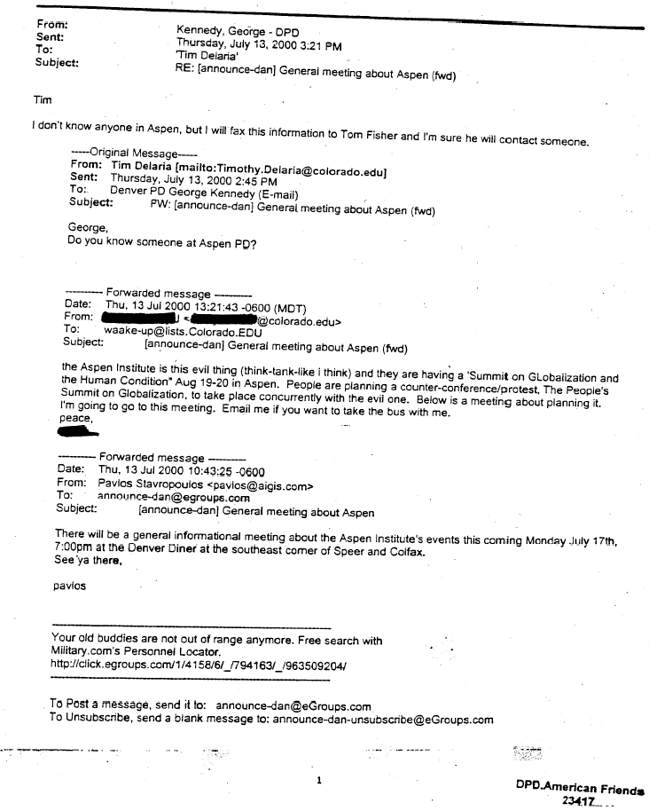
Intercepted email regarding a protest of the Aspen Institute’s Summit on Globalization and the Human Condition

Slide 30
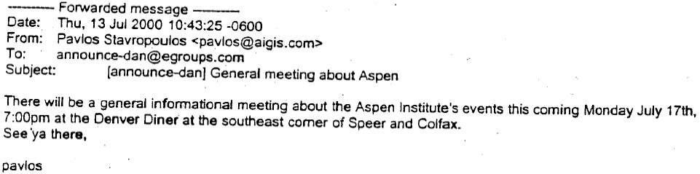

Slide 31
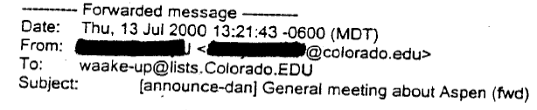

Slide 32
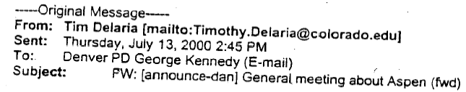

Slide 33
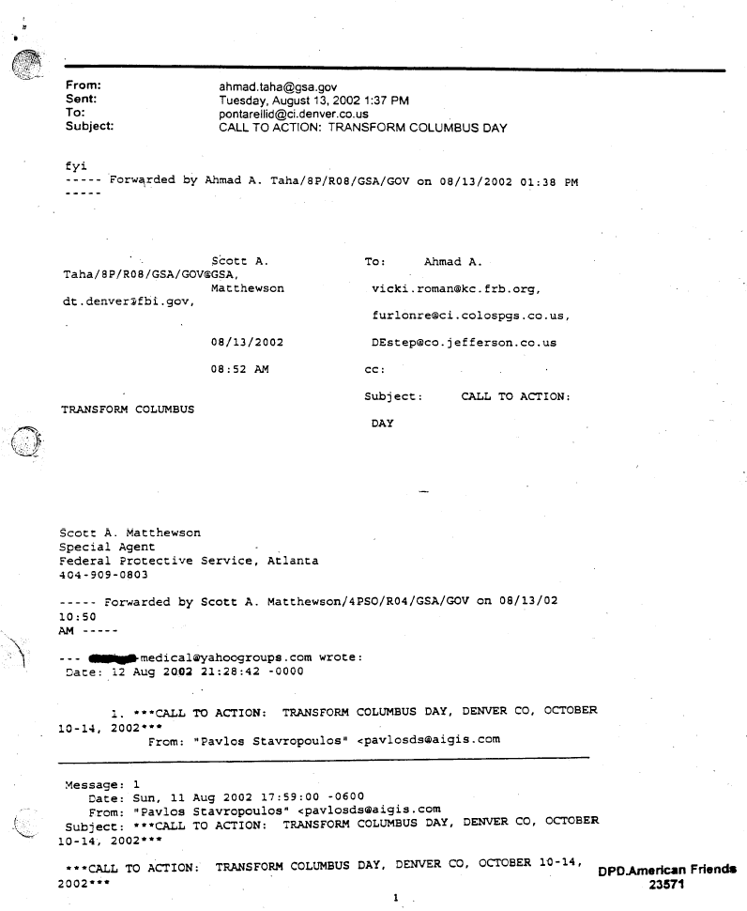
Intercepted email regarding plans for Transform Columbus Day

Slide 34

Intercepted email regarding plans for Transform Columbus Day

Slide 35
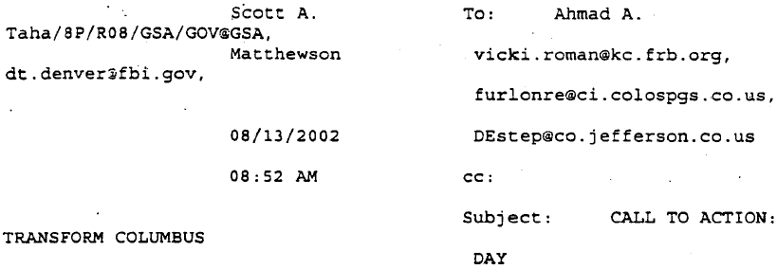
Intercepted email regarding plans for Transform Columbus Day

Slide 36
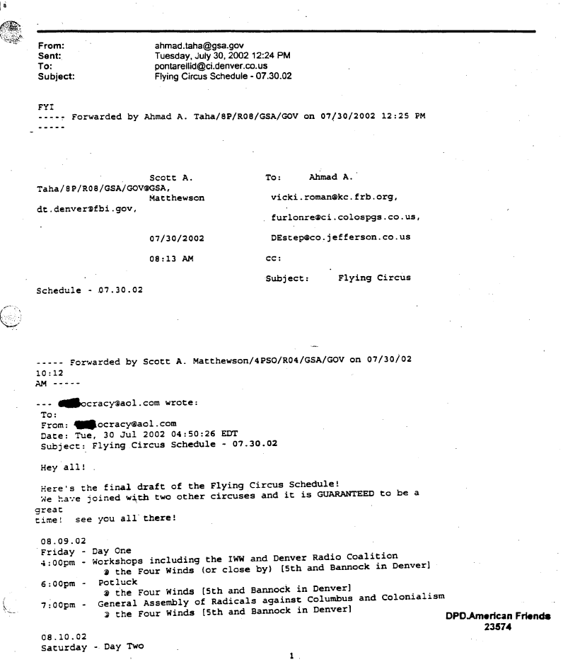
Intercepted email regarding schedule for Denver activist event

Slide 37
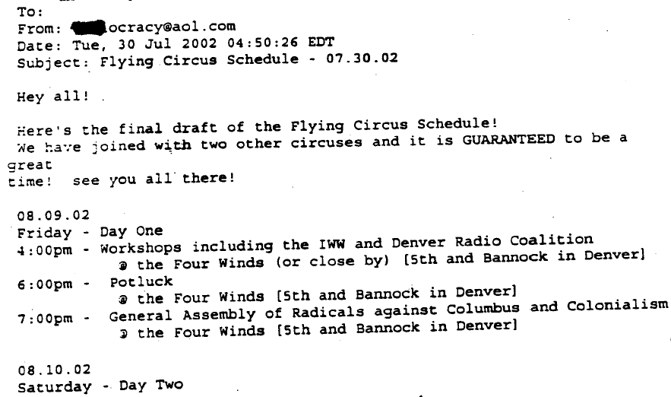

Slide 38
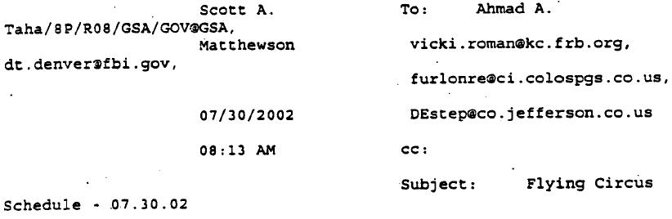

Slide 39
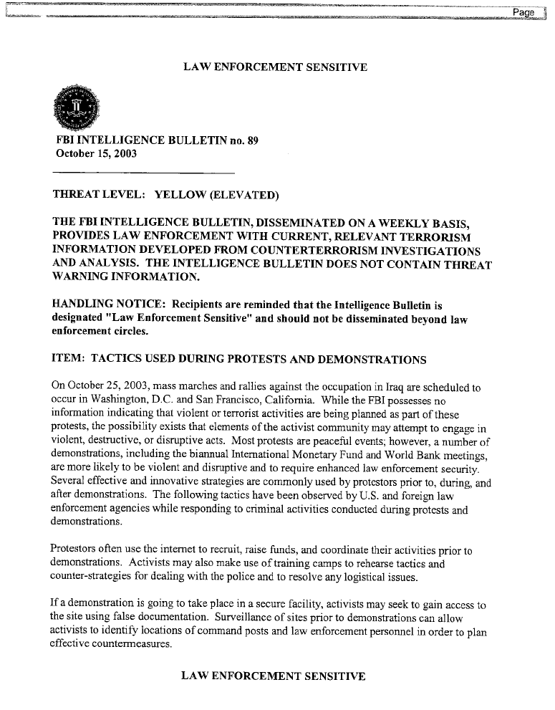
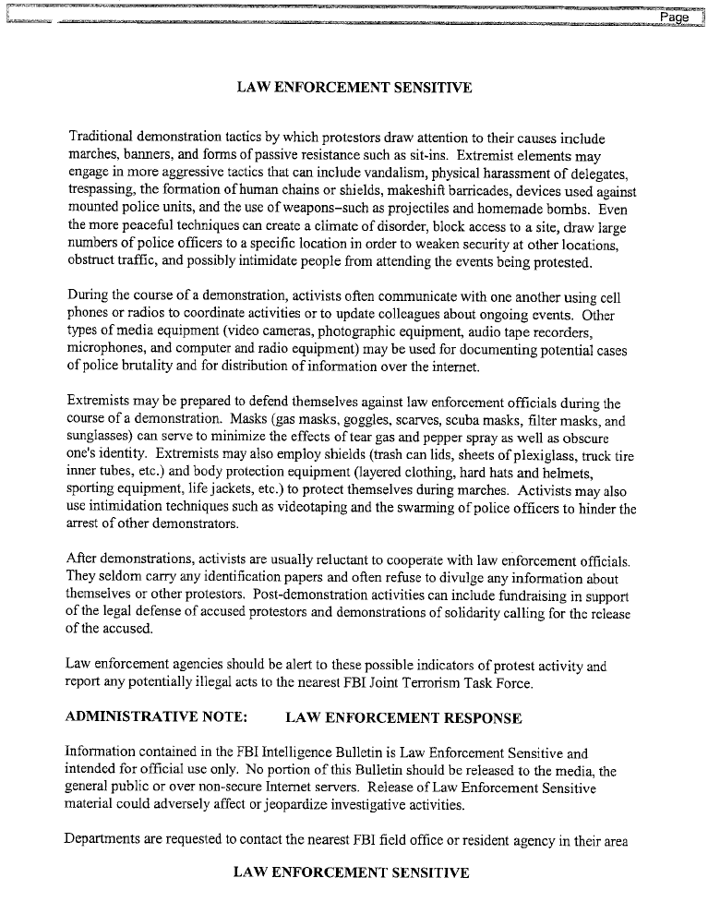
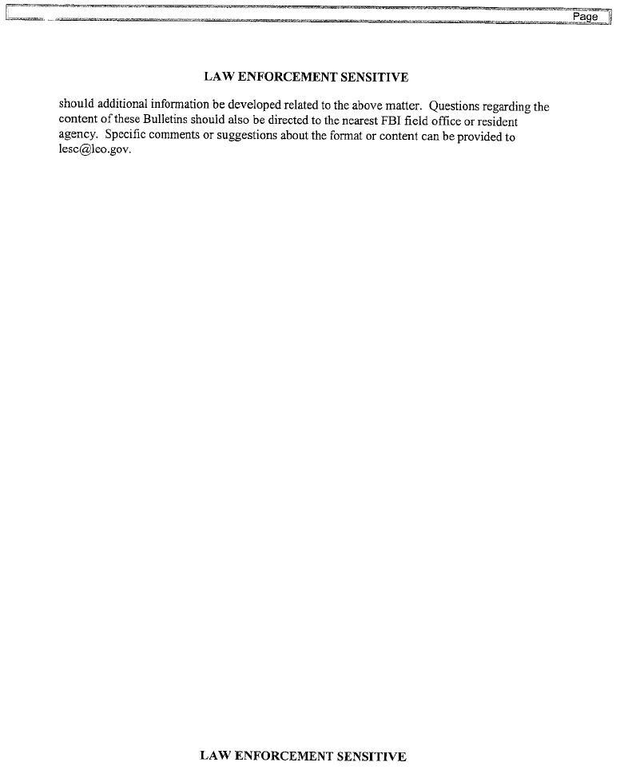

Slide 40
Page 1

Slide 41
Page 2

Slide 42
Page 2

Slide 43
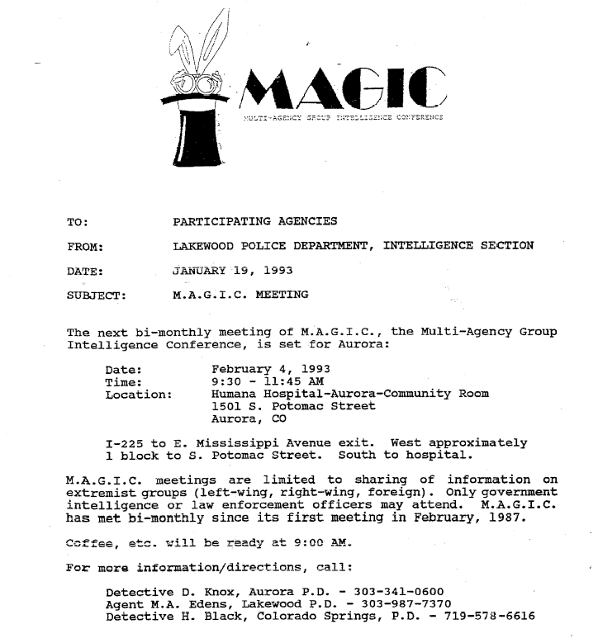
Multi-Agency Group Intelligence Conference (MAGIC) Meeting

Slide 44
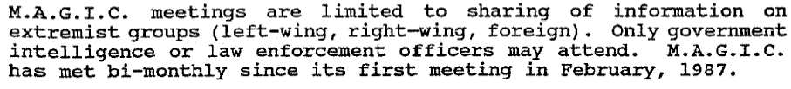
Multi-Agency Group Intelligence Conference (MAGIC) Meeting

Slide 45
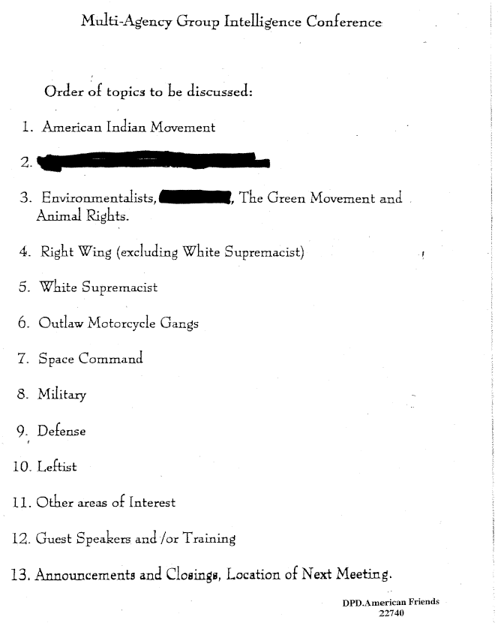
MAGIC Agenda

Slide 46
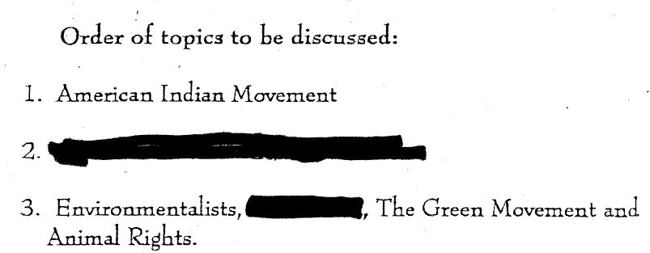
MAGIC Agenda

Slide 47
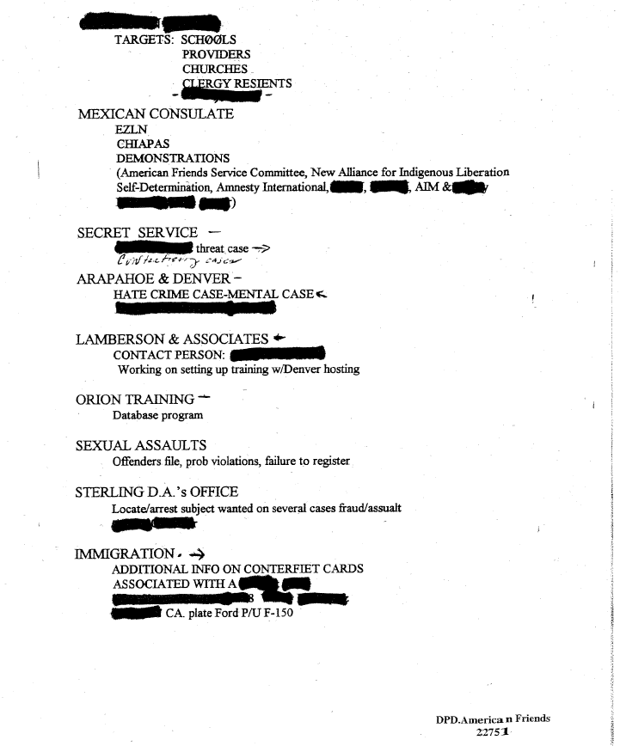
Another MAGIC Agenda

Slide 48

Another MAGIC Agenda

Slide 49
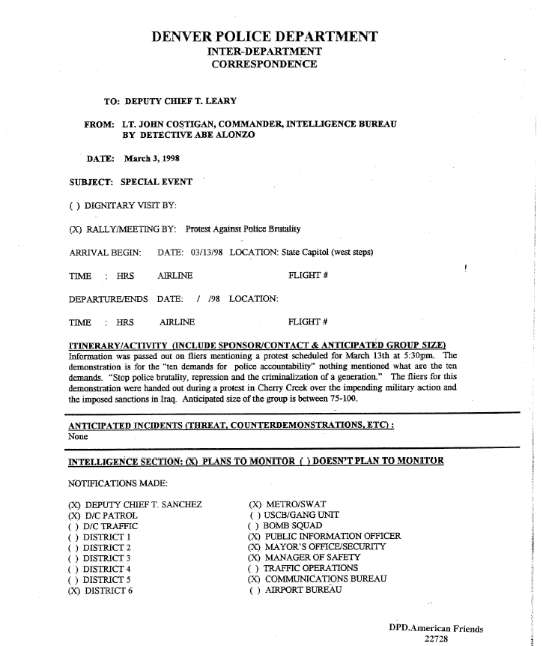
Protest against police brutality listed as “MAGIC info”

Slide 50
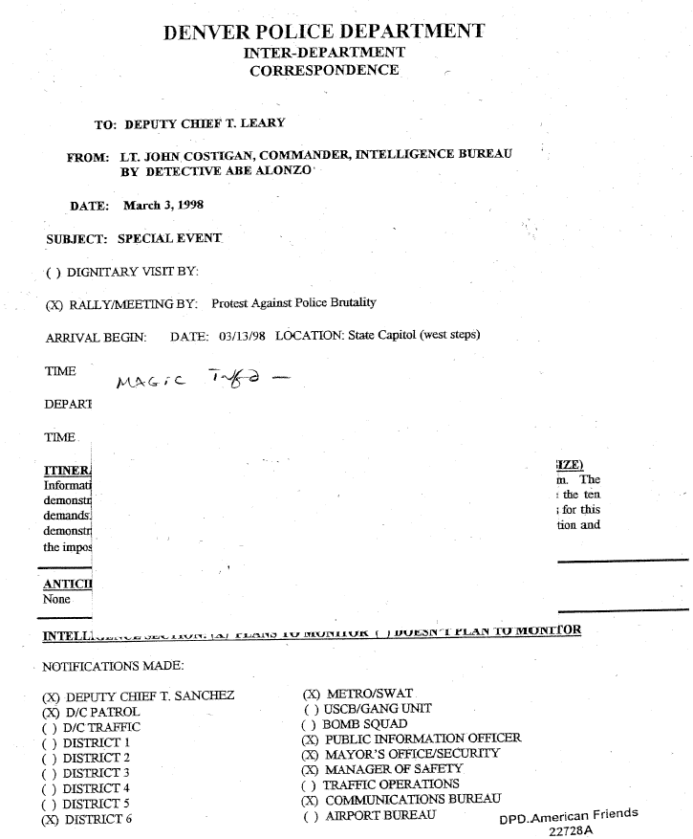


Slide 51
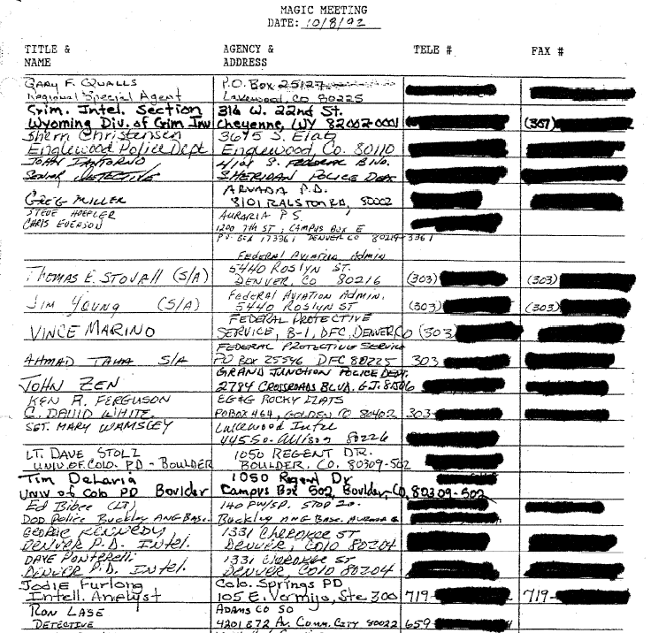

Sign-up sheet for MAGIC Meeting

Slide 52
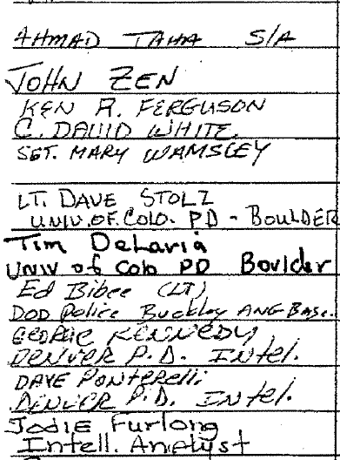

Slide 53
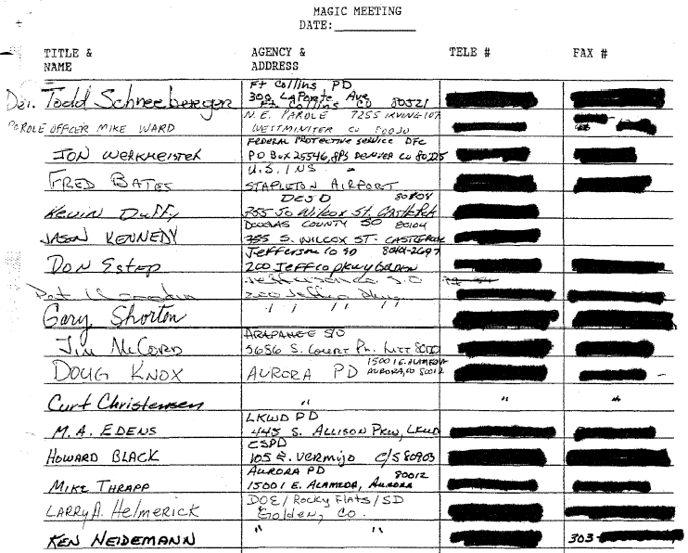


Slide 54
ACLU of Colorado
Freedom of Information Act (FOIA)
request re:
Joint Terrorism Task Force (JTTF)

